Slide 1
Economic Outlook:
The Inflation Clock Keeps Ticking: Stubbornly Elevated
Prices Push Rates Higher for Longer With a Modest Recession
January 2023
Lindsey M. Piegza, Ph.D.
Chief Economist

Slide 2
The Labor Market and the Consumer
Tight labor market conditions carry into 2023 with some reprieve, while consumer spending declines further amid still-elevated prices.

Slide 3
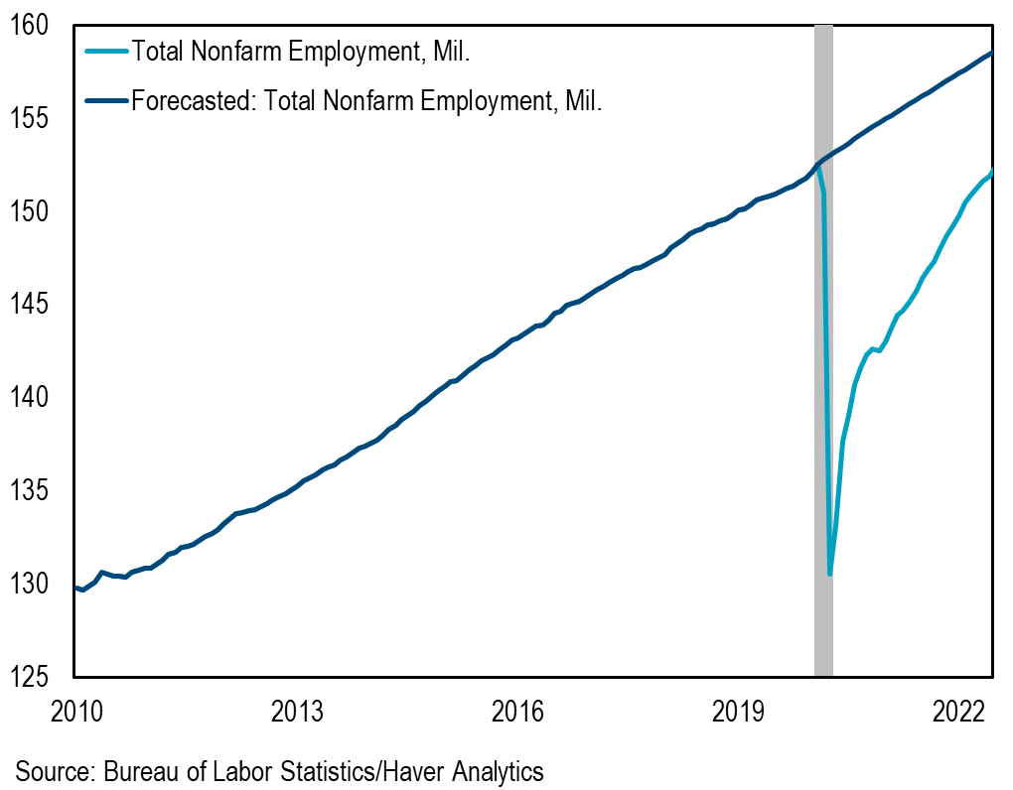
Total Employment Still Behind Pre-Covid Levels
While job creation remains solid, much of the improvement has been replacing jobs lost during the Covid-19 recession
Between March and April 2020, the U.S. lost 22M jobs
In July 2022, the labor market finally recaptured all of the 22M jobs lost at the onset of the Covid-19 pandemic
Total nonfarm employment remains around 6.0M jobs short of potential job growth at 154M as of December

Slide 4
3.5% U.S. Unemployment Rate; 62.3% Participation Rate
The decline in the unemployment rate shows further improvement in labor market conditions
Household employment rose by 717k in December, and the labor force rose by 439k, resulting in an unemployment rate of 3.5% in December, a five-decade low
The decline in the unemployment rate reflects more employment and sidelined workers
Returning workers will push unemployment rate higher
The labor force participation rate gained from 62.1% to 62.3% in December, a three-month high but still below the pre-crisis peak of 63.4%
Fewer workers is far from the ideal scenario particularly as businesses remain desperate for workers

Slide 5
The Housing Market
Higher borrowing costs continue to slow activity, but a lingering supply shortfall provides welcome support.

Slide 6
Home Prices Still Elevated
Demand is still relatively solid, supply is still relatively limited, keeping pressure on prices
Year-over-year, the 20-city home price index rose 8.6% in October, following a 10.4% gain in September and down from the 21.3% peak in April, the largest gain on record
Nationally, home prices rose 9.2%, following a 10.7% rise the month prior, and down from the 20.6% peak reached in April, the largest gain in the history of the index dating back to 1987
Price growth is not limited to downtown, urban markets

Slide 7
Production and Supply Chain Disruptions
With incremental signs of improvement, ongoing limitations to global trade hinge on international policy adjustments.

Slide 8
Manufacturing Activity Slowing
Even with a relative decline in spending, positive nominal spending is keeping pressure on producers
Producers face labor shortages and lingering supply chain disruptions which have improved but remain historically high
Shortages reported for lumber, tires, wire, etc. leading to extended wait times, higher prices and inventory complications
The ISM declined from a near-term peak of 60.8 in October 2021 to 48.4 as of December 2022
The China Manufacturing PMI fell to 47.0 in December, bouncing along breakeven since June 2021
Solution to supply chain disruptions will depend on global policy, trade relations and geo-response to the virus – even domestic producers are impacted resulting in price pressures

Slide 9
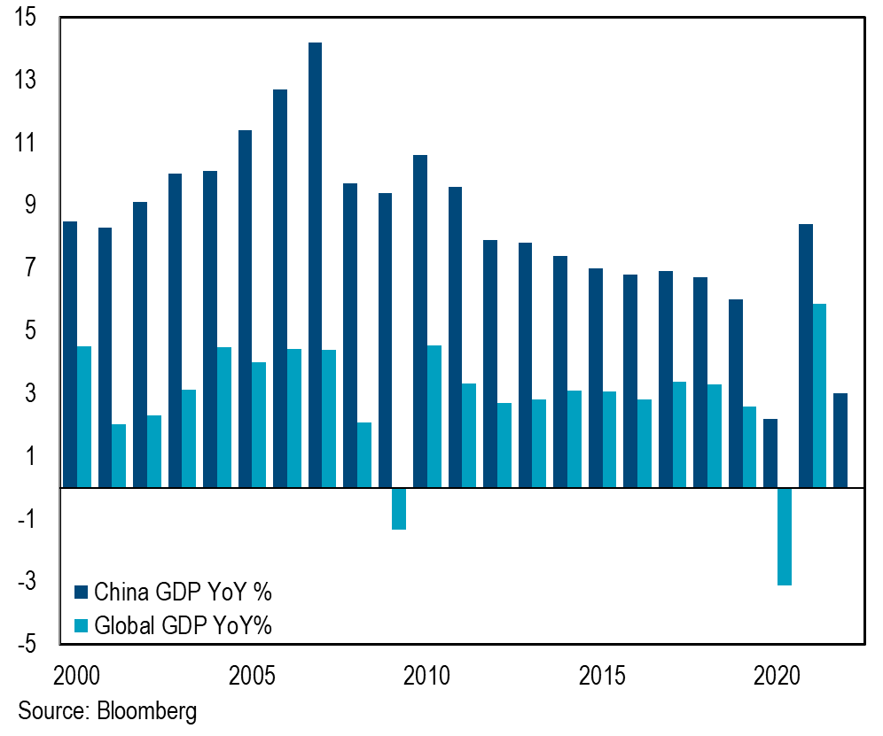
Chinese and Global GDP
Chinese GDP grew 2.9% in Q4 and 3% for the year
While the annualized pace may mark the second-slowest growth rate in four decades, the near-term data suggests the Chinese economy may be able to recover faster than expected as the country continues roll back its COVID safety protocols and restrictions
Global GDP rose 5.9% in 2021, following a 3.1% decline in 2020

Slide 10
Monetary Policy, Inflation and Growth
A slower ascent in policy results in ultimately higher rates as inflation remains elevated amid a modest technical recession.

Slide 11
Inflation Remains Elevated with Core Services Pushing Higher
The CPI fell 0.1% in December but rose 6.5% over the past 12 months, down from the 7.1% annual increase reported in November
The core CPI rose 0.3% in December and 5.7% year-over-year, down from the 6.0% annual gain in November
Core services, on the other hand, continues to push higher, up 7.0% year-over-year in December, following a 6.8% annual increase in November

Slide 12
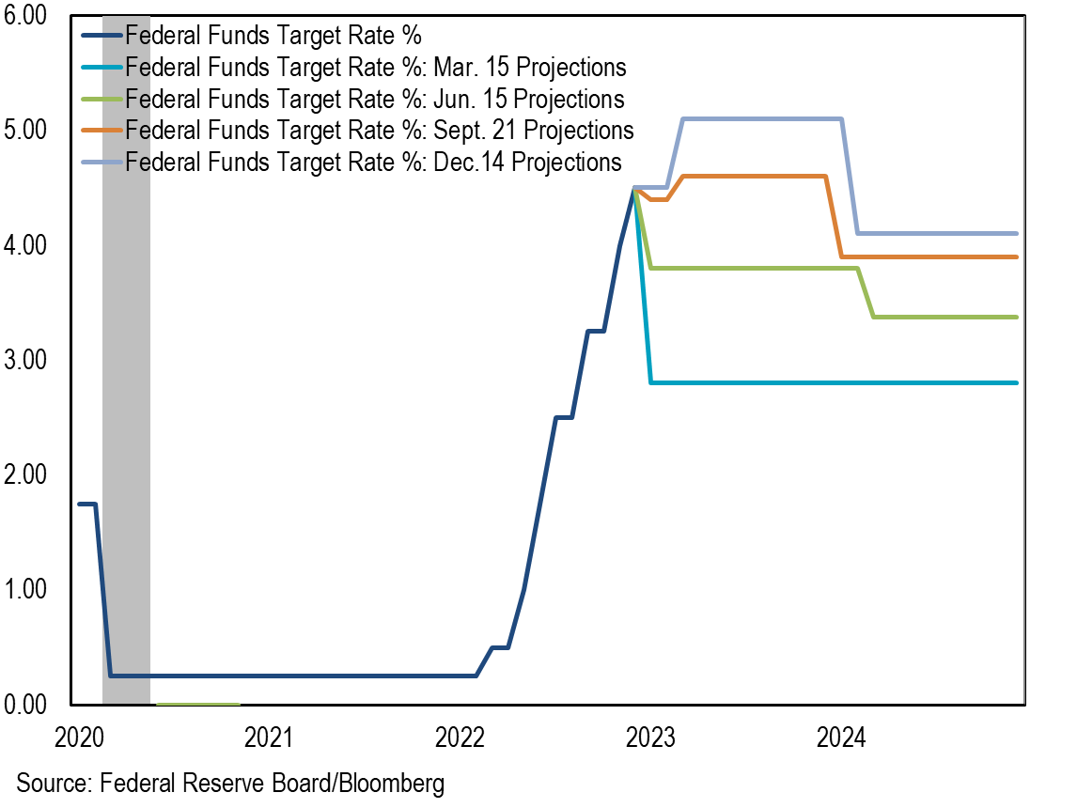
Consistently Higher Fed Forecast for Terminal Rate
?
At the Nov. press conference, Chairman Powell was clear that the risk isn’t that the Fed overtightens but that they do too little to control inflation
The Committee revised up its forecast for rates by 230bps since the initial March forecast
With inflation stubbornly elevated, the Fed revised expectations higher – for both rates and inflation – a fourth time in the final SEP release of 2022
SEP | Terminal FF Rate | PCE
Mar. 15 | 2.8% | 4.3%
Jun. 15 | 3.8% | 5.2%
Sep. 21 | 4.6% | 5.4%
Dec. 14 | 5.1% | 5.6%

Slide 13
Inflation Remains the Primary Driver of the Fed’s Policy Directive
As the Fed seeks to achieve a “sufficiently restrictive” level of policy to reinstate the Committee’s desired condition of stable prices, the still-elevated level of inflation is not yet convincing that policy has moved into the proper range even under the most generous or optimistic assumptions
Policy officials have predicted a meaningful pullback in prices for the better part of the past two years that has failed to materialize, suggesting an under-appreciation for the complicated nature of supply-side pressures

Slide 14
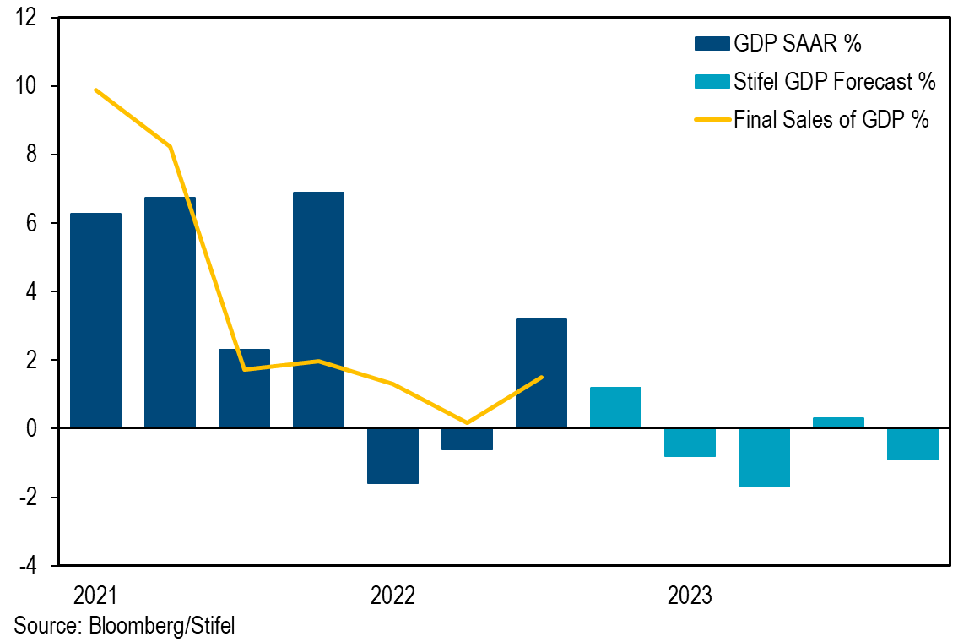
U.S. Economy Showing Signs of Weakness
The Fed has vowed to raise rates enough to root out inflation but will it work?
Typically, the Fed raises rates when the economy is overheating versus struggling to gain legs post-pandemic
The majority of price pressures stem from supply side constraints, limiting impact of Fed rate hikes
With an aggressive rate path, growth is likely to slow further into recession
GDP rose 3.2% in Q3 2022, following two consecutive quarters of decline
Excluding trade and inventories, final sales to domestic purchasers rose 1.5%

Slide 15
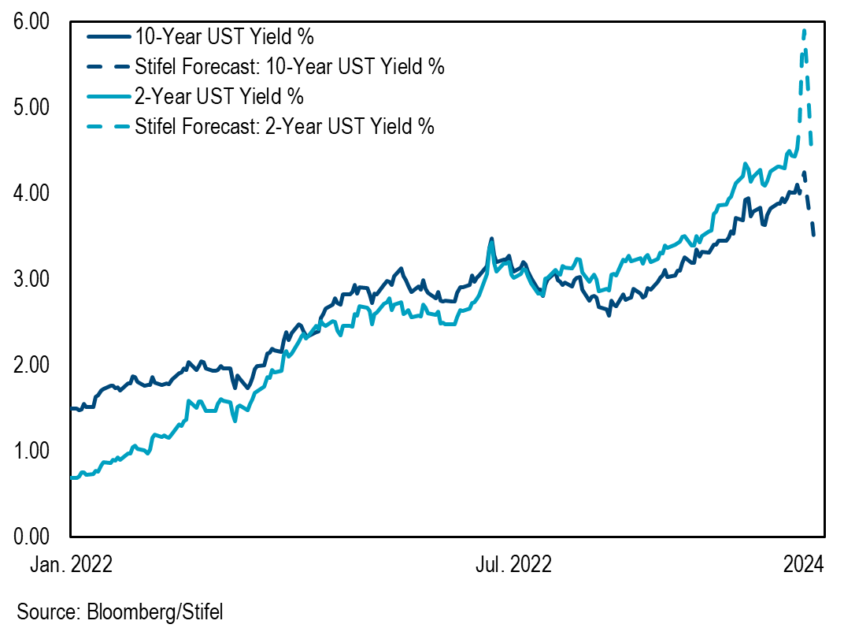
What Does This Mean for Rates?
The short end of the curve will continue to move higher along with the Fed, while the long end will struggle to keep up with the Fed as policy intentionally tightens us into or further into a recession

Slide 16
Fiscal Policy and Market Dysfunction
A growing disconnect between monetary and fiscal policy compounds the challenge for the Fed to maintain orderly markets and tackle inflation.

Slide 17
U.S. Debt Rises to All-Time High: $31T vs. $25T Economy
Forecast by 2032: $40.2T
In FY 2022, the federal government ran a deficit of $1.38 trillion
The deficit for FY23, of course, will be markedly less than the year prior given the significant reduction in outlays from the waning federal response to the pandemic
Total public debt outstanding rose from $28T in FY 2021 to $31T in FY 2022, an all-time high
Total public debt is forecasted to reach over $40T by 2032

Slide 18
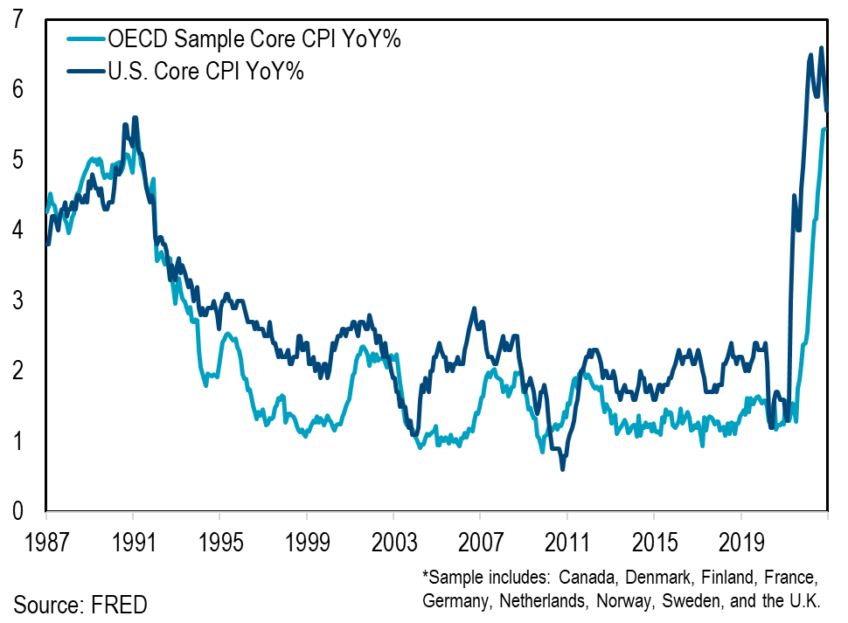
U.S. Inflation Higher than Abroad
Countries are reeling from supply-side constraints
U.S. inflation has been exacerbated by fueling demand-side metrics and labor costs resulting from fiscal policy measures
U.S. inflation continues to outpace other countries, rising 5.7% as of December vs. 5.4% elsewhere in the developed world

Slide 19
Dark Horse
The U.S. economy will continue to face numerous risks including those not yet considered real-time threats as most seek to move beyond COVID and resolution to current conflicts.

Slide 20
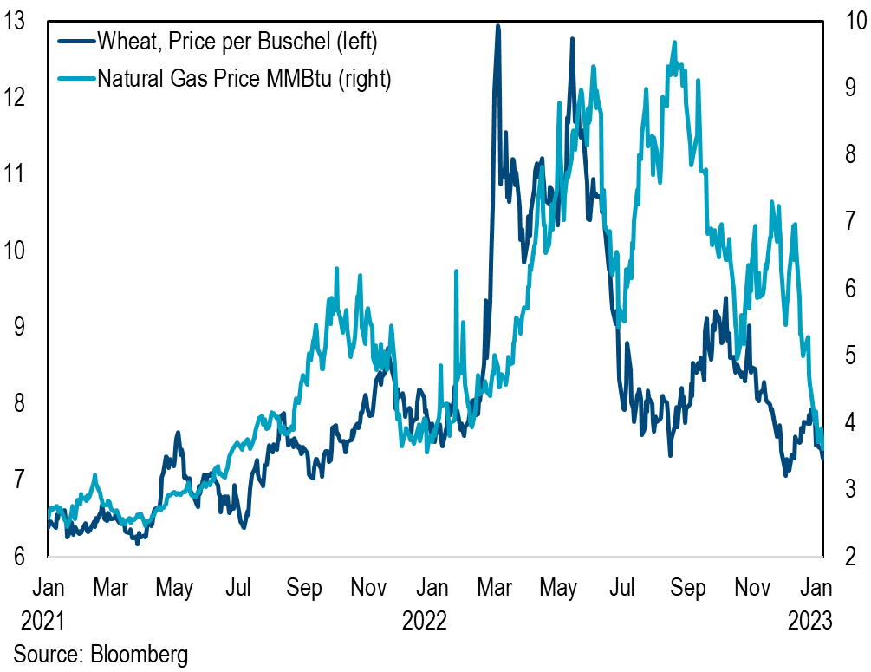
Commodity Prices Felt Renewed Hit as Conflict Erupted Abroad
Prices were already on the rise after Covid-19, international conflict is adding pressure
Commodity prices have cooled amid fears of slowing global growth but prices are still elevated
The cost of staples – bread, pasta, and flour – remains elevated as the world faces uncertain grain stockpiles, although shipments have resumed
The fastest way to derail consumer is heightened energy prices, but there is no alternative for food supply
Natural gas prices are at $3.61/MMBtu as of January 10, down from a $9.68 peak in August

Slide 21
Thank you

Slide 22
Disclosures and Disclaimers
The Fixed Income Capital Markets trading area of Stifel, Nicolaus & Company, Incorporated may own debt securities of the borrower or borrowers mentioned in this report and may make a market in the aforementioned securities as of the date of issuance of this research report. Please visit the Research Page at www.stifel.com for the current research disclosures applicable to the companies mentioned in this publication that are within Stifel’s coverage universe.
The information contained herein has been prepared from sources believed reliable but is not guaranteed by Stifel and is not a complete summary or statement of all available data, nor is it to be construed as an offer to buy or sell any securities referred to herein. Opinions expressed are subject to change without notice and do not take into account the particular investment objectives, financial situation or needs of investors. Employees of Stifel or its affiliates may, at times, release written or oral commentary, technical analysis or trading strategies that differ from the opinions expressed within. No investments or services mentioned are available to “private customers” in the European Economic Area or to anyone in Canada other than a “Designated Institution”. The employees involved in the preparation or the issuance of this communication may have positions in the securities or options of the issuer/s discussed or recommended herein.
Stifel is a multi-disciplined financial services firm that regularly seeks investment banking assignments and compensation from issuers for services including, but not limited to, acting as an underwriter in an offering or financial advisor in a merger or acquisition, or serving as a placement agent in private transactions. Moreover, Stifel and its affiliates and their respective shareholders, directors, officers and/or employees, may from time to time have long or short positions in such securities or in options or other derivative instruments based thereon.
Stifel Fixed Income Capital Markets research and strategy analysts (“FICM Analysts”) are not compensated directly or indirectly based on specific investment banking services transactions with the borrower or borrowers mentioned in this report or on FICM Analyst specific recommendations or views (whether or not contained in this or any other Stifel report), nor are FICM Analysts supervised by Stifel investment banking personnel; FICM Analysts receive compensation, however, based on the profitability of both Stifel (which includes investment banking) and Stifel FICM. The views, if any, expressed by FICM Analysts herein accurately reflect their personal professional views about subject securities and borrowers. For additional information on investment risks (including, but not limited to, market risks, credit ratings and specific securities provisions), contact your Stifel financial advisor or salesperson.
Our investment rating system is three‐tiered, defined as follows:
Outperform ‐ For credit specific recommendations we expect the identified credit to outperform its sector
specific peers over the next six months.
Market perform ‐ For credit specific recommendations we expect the identified credit to perform approximately
in line with its sector specific peers over the next six months.
Underperform ‐ For credit specific recommendations we expect the identified credit to underperform its sector
specific peers over the next six months.
Additional Information Is Available Upon Request
I, Lindsey Piegza, certify that the views expressed in this research report accurately reflect my personal views about the subject securities or issuers; and I certify that no part of my compensation was, is, or will be directly or indirectly related to the specific recommendations or views contained in this research report.
© 2023 Stifel, Nicolaus & Company, Incorporated, One South Street, Baltimore, MD 21202. All rights reserved.

