Slide 1


DIVERSITY…
It’s Personal
Becoming a Champion for Change

Slide 2

How do you define diversity?
di-vur’-si-te: noun;
The fact or quality of being
diverse; difference
Variety or multiformity
Diversity and Inclusion Begins With You

Slide 3
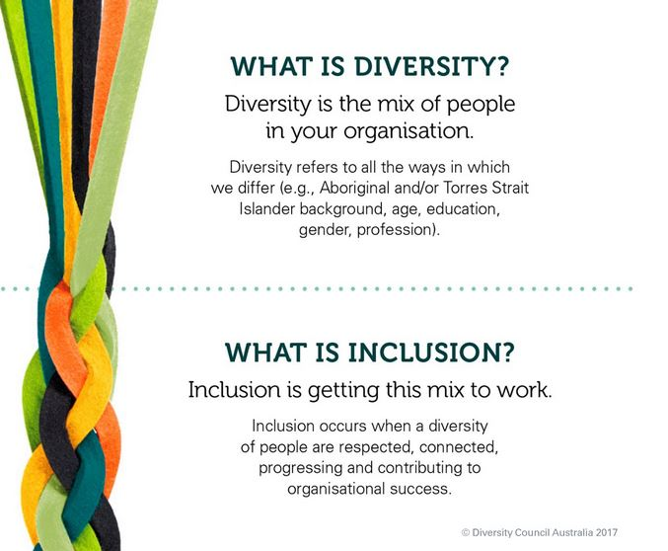
Inclusivity Succeeds When Diversity is Embraced

Slide 4
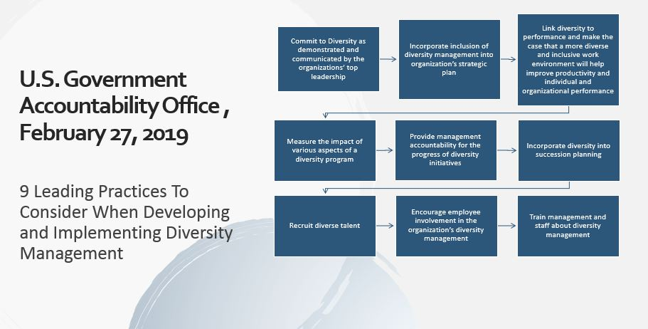

Slide 5

The Coca-Cola Company Diversity Story
“The white guys would …say, ‘This is about everyone but me.’ I said, ‘No, its not. We’re not here to invalidate you, your contribution or your opportunity to advance. We’re just here to validate everyone, and not everyone has been validated at work.’”
Mr. Bucherati
Director of Workplace Fairness
Coca-Cola Company
From Diversity Success to Failure to…

Slide 6
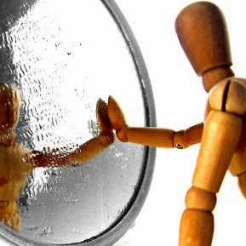

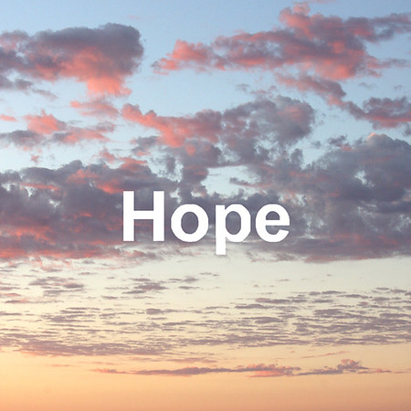
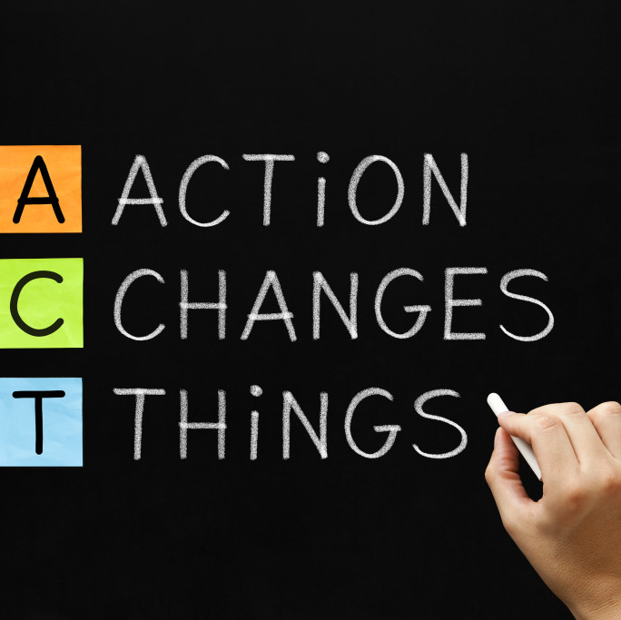
Diversity Is
A Personal Journey
Self-Aware
Commitment
What do I see?
How do I feel?
What do I believe must change?
It Begins With You…
Action
Champion
What will I do?
I am a Champion for Change

Slide 7
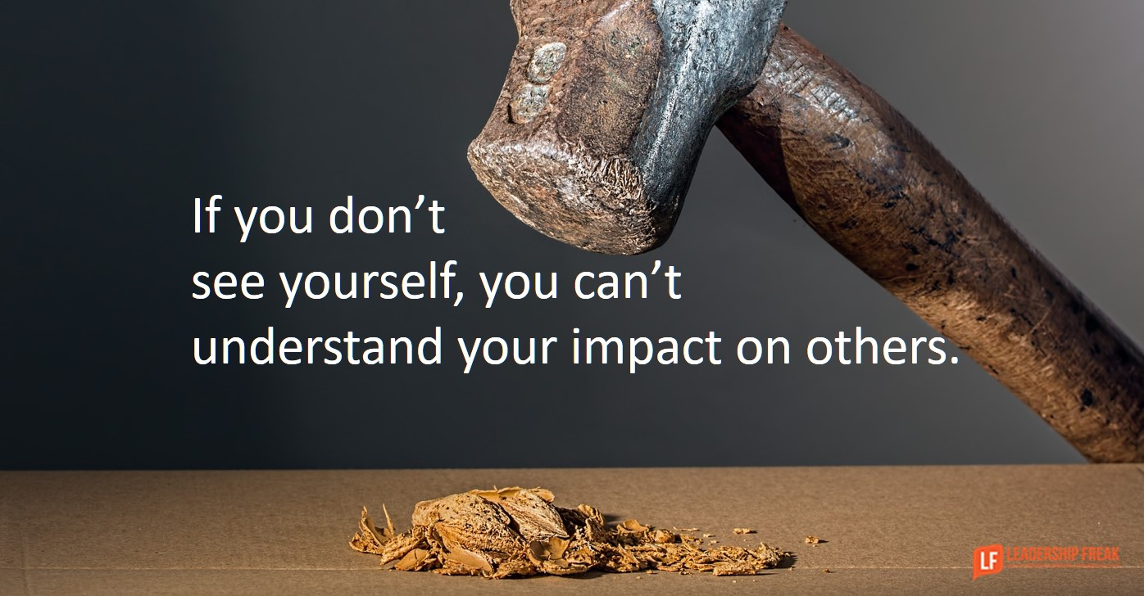

Slide 8
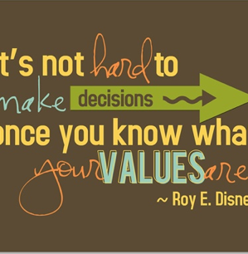
Embracing Diversity Begins With Being
Self-Aware
Self-Aware
  Continuous Self-Reflection
  Critically Analyze Personal Actions
  Pursue Personal Development
  Maintain Personal Accountability
Recognition of who I am and who I want to be…

Slide 9
Sometimes we don’t realize the bigotry or fear within us

Slide 10

Diversity and Our Values
Racism
Gender
Implicit
Bias
Unconscious
Bias
FEAR
Micro-Aggression
Religion
Oppression
What happens when other influences impact our core values?

Slide 11
“Once you put a face in a category then
that can also trigger your beliefs and feelings
about the people who are in that category.
And then that can lead you to treat them
differently”
Dr. Jennifer Eberhardt
Author, Stanford University

Slide 12
How do your values, beliefs, judgment, personal motivation and driving passion impact and influence others?
Compassion
Empathy
It Begins with you

Slide 13
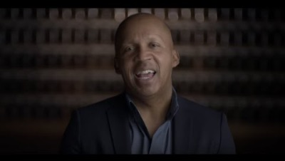
Everyone has a story
https://www.youtube.com/watch?v=JfZPl4CFEUc
Get to Know Me…

Slide 14
Get to Know Me…

Slide 15
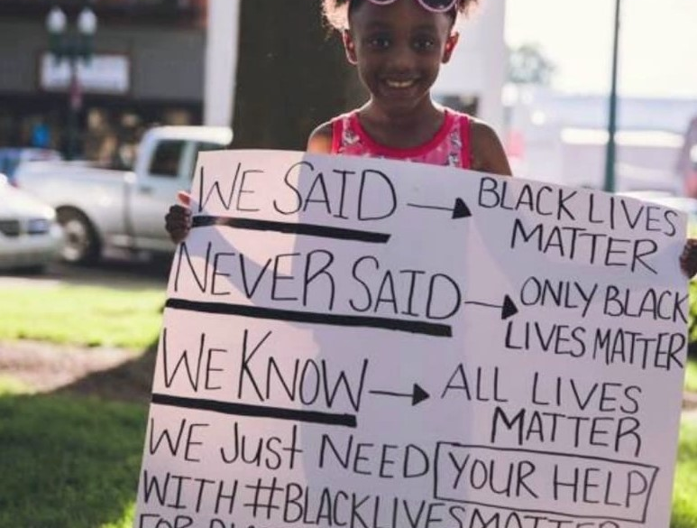
Candid Conversations
Bias and Me

Slide 16
ASSUMPTIONS
What we see…
What we hear…
What we believe…

Slide 17
Black Lives Don’t Matter

Slide 18
Hamilton, GA Police Chief Gene Allmond and Sgt. John Brooks, June 2020

Slide 19
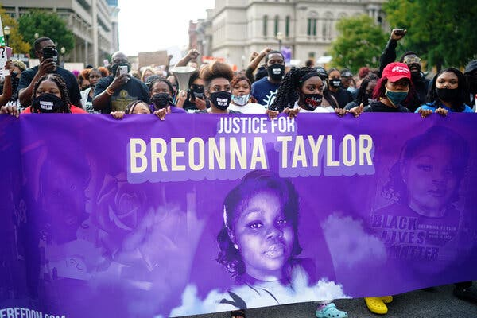
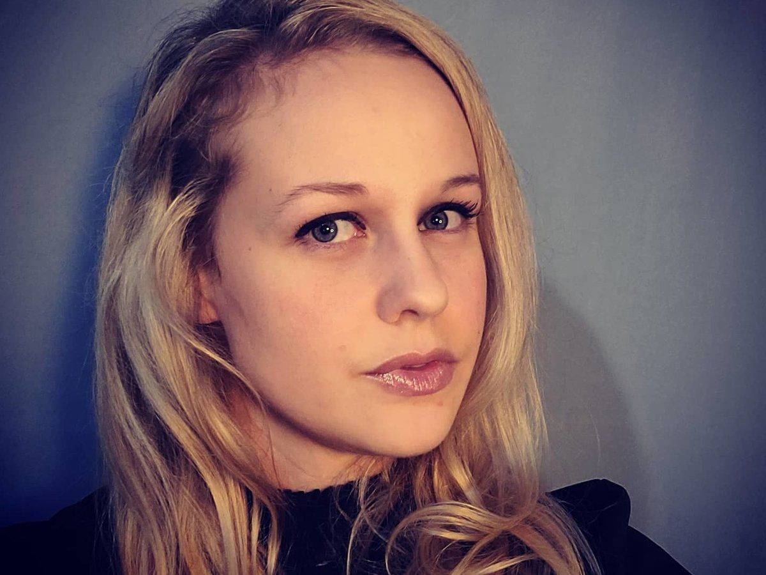
We See… Black Lives Don’t Matter
Breonna
Rebekah

Slide 20
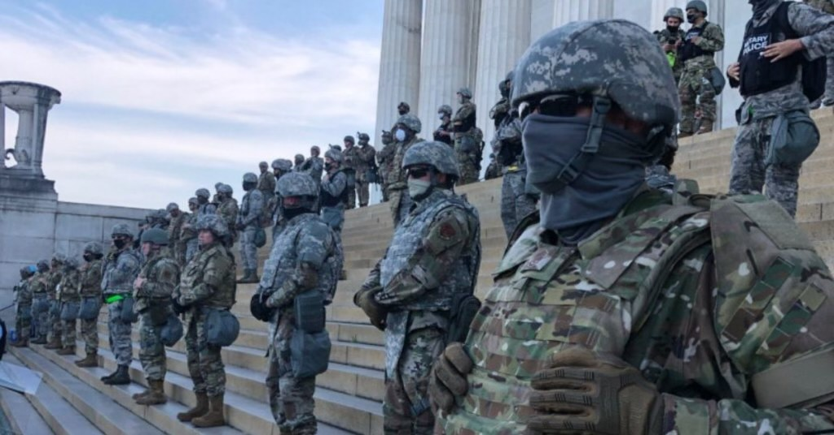
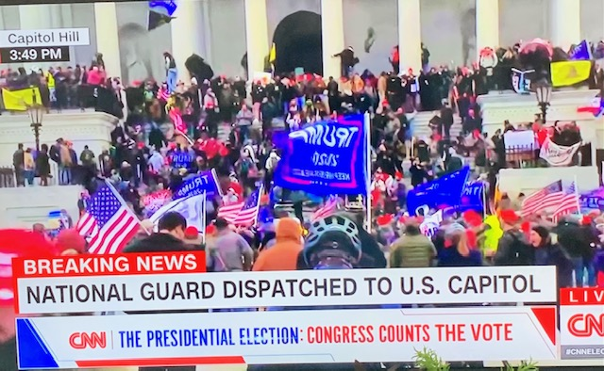
What We see…
What we hear…
What we believe…

Slide 21

FEAR
Assumptions and Fear
It’s Not a Male or Specific Race’s Problem – It’s Personal to All of Us
Fear of evoking oppressed versus the oppressor syndrome “It’s us against them.”
Fear of WHAT others ASSUME about me
Fear of striking the match to a powder-keg of bad emotions (Its in the past – let it go)
Fear NOTHING will change
Fear of the Unknown “I don’t understand!”
Don’t blame me - Don’t judge me… for things that happened in the past

Slide 22
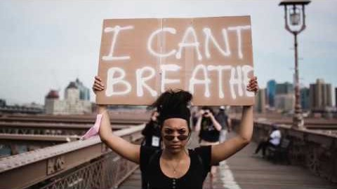
Champions Matter
Asian American Christians For Black Lives Matter

Slide 23
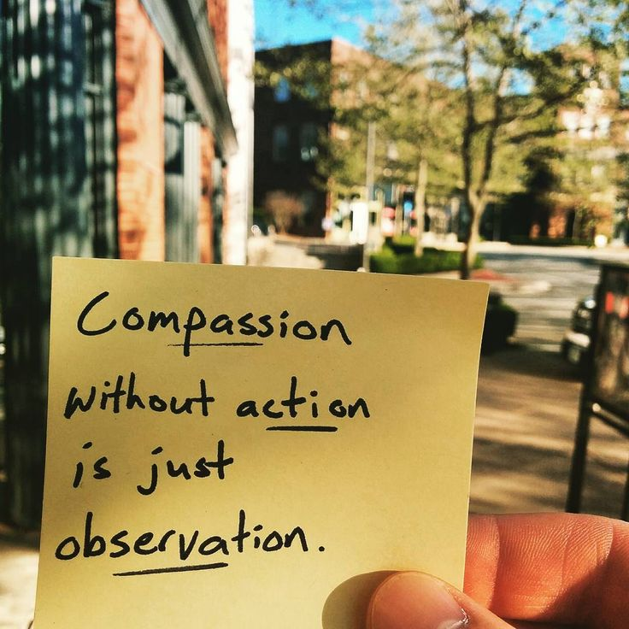
What I believe must change requires more than reflection and recognition
I am committed

Slide 24
Commitment
“Commitment is what transforms a promise into reality”
Abraham Lincoln
Helps Us See
Makes Us Think
Encourages Empathy
Moves Us To Action

Slide 25
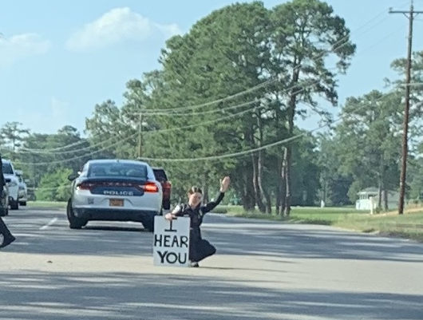
When Commitment is Personal
Others will know it

Slide 26
COMMITMENT REQUIRES
ACTION

Slide 27
BLAH BLAH BLAH…
diversity

Slide 28





The Problem
Lack of Diverse Leadership
Check the Box Policies
Lack of Accountability
Ineffective Planning
No Sustainable Change
Is This Us -
Diversity Commentary without Commitment?

Slide 29
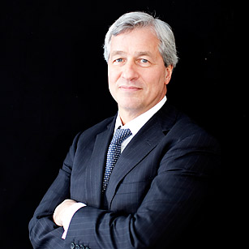
Commitment is Action
JPMorgan’s Jamie Dimon slashed worker bonuses for not helping diversity efforts
The company plans to make a five-year, $30 billion commitment to advance racial equity
By Brittany De LeaFOXBusiness
October 9, 2020
“Systemic racism is a tragic part of America’s history. We can do more and do better to break down systems that have propagated racism and widespread economic inequality, especially for Black and Latinx people. It’s long past time that society addresses racial inequities in a more tangible, meaningful way.”
Jamie Dimon
President/CEO

Slide 30
“In the end, racial diversity will not be ushered in by pledges, slogans, or well compensated czars. Yes, change will require resources and resolve, but no amount of money, no degree of effort, will succeed alongside a willful negation of our shared humanity.”
            Pamela Newkirk
            NYU Journalism Professor
            Diversity, Inc. Magazine

Slide 31
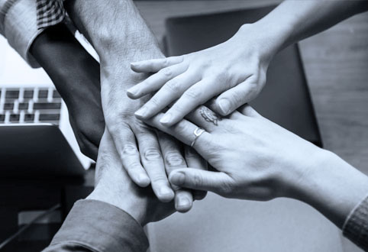
Action
When it’s Personal – Leaders are Proactive:
Know the Culture – Change the Culture
Personally Set Expectations
Incorporate Diversity into Organization’s Strategic Plan
Invest early in long-range planning for diverse leadership
Develop “REAL” Succession Planning

Slide 32
Develop Real Succession Planning
R Rigorous (Process Driven)
E Effective(Measure/Monitor)
A Accountable (Ownership)
L Long-Term (Plan -
for the Talent, Not the Role)
*Career Mapping
*Training
*Mentoring
*Sponsorships

Slide 33
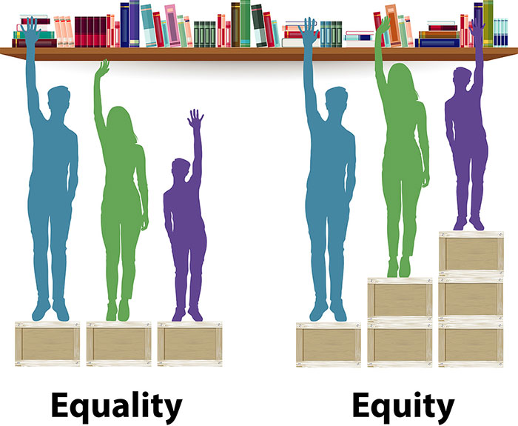

Slide 34
DIVERSITY
Diverse cultural perspectives can inspire creativity and drive innovation.
Diverse Local market knowledge and insight makes a business more competitive and profitable.
Cultural sensitivity and insight, means higher quality, targeted marketing, delivery of meaningful value to broad diverse cultures.
Drawing from a culturally diverse talent pool allows an organization to attract and retain the best talent with greater opportunity for personal and professional growth.
Diverse teams are more productive and perform better.
Matters…..

Slide 35
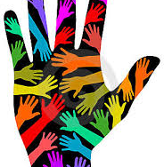
Champions
I AM
COMMITTED
Making it Personal

Slide 36
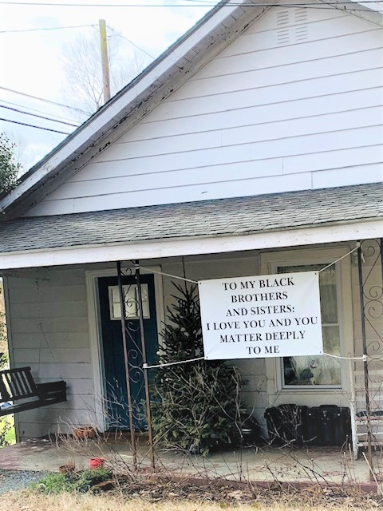
When Commitment is personal
WE become champions of change

Slide 37
He who passively accepts evil is as much involved in it as he who helps to perpetrate it. He who accepts evil without protesting against it is really cooperating with it.
Dr. Martin Luther King, Jr.

Slide 38
Actions of Champions (Advocacy and Accountability)
Engage with diverse groups
Encourage inclusivity
Get to know others who do not look like me - Listen, Hear, Feel
Be Vocal – Speak Up and state objections
Act….

Slide 39
Taking a Stand means when it is the right thing to do…
Do the Difficult Thing

Slide 40
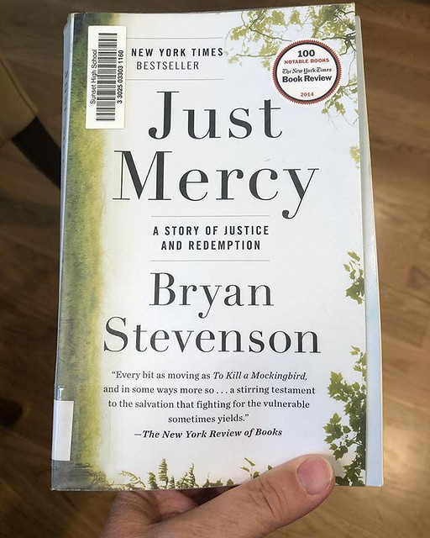
Stand
How to Take a
Get Proximate
Change the Narrative
Have Hope
Do the Difficult Thing
Bryan Stevenson
Founder, the Equal Justice Initiative

Slide 41
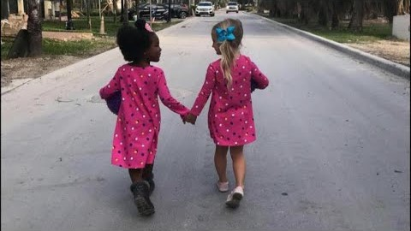
Diversity…Make it Personal

Slide 42
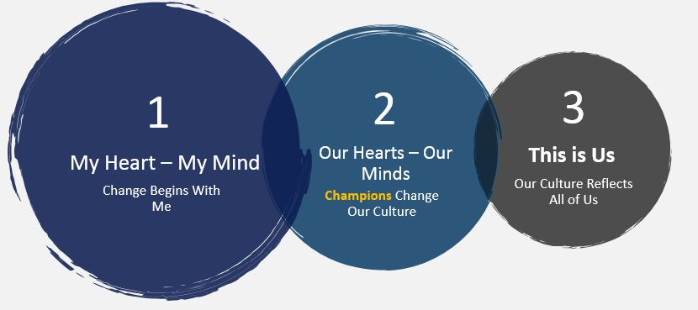
Diversity…It’s Personal
Changing “Hearts and Minds"

Slide 43

Let’s
Talk
How Will You Influence Change?

Slide 44
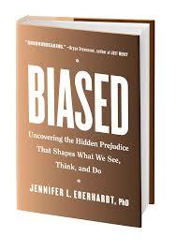


Perspectives
Worth the read…
Jennifer Eberhardt
Bryan Stevenson
Jemar Tisby
Professor
Activist
Pastor
Biased: Uncovering the Hidden Prejudice That Shapes What We See, Think, and Do is a study on race and our everyday interactions. The book suggest that in order to overcome our racial biases, we must first acknowledge them.
Just Mercy is the true story about the growth of the Equal Justice Initiative that challenges racial and economic injustice and protects human rights for the most vulnerable people in American society.
How to Fight Racism is a handbook with suggestions and real life examples for readers who are committed to taking a stand for justice.

Slide 45
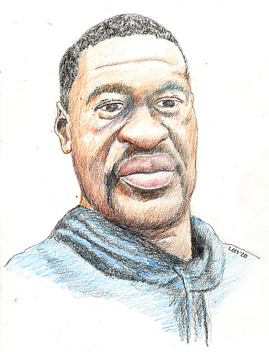

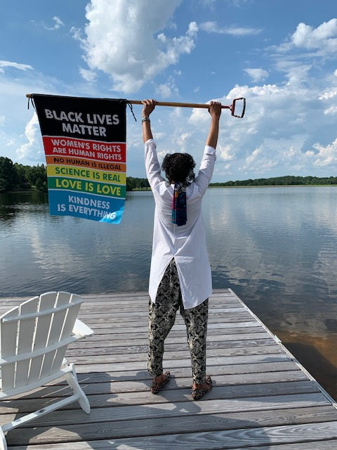
Thoughtful Research and Videos
Hamilton, GA Police Chief Video
https://www.wrbl.com/news/local-news/hamilton-police-chief-sergeant-resign-after-bodycam-footage-showing-them-using-racial-slurs-surfaces/
Government Accounting Office
NYT Reconstructs Breona Taylor Shooting
NYT Reconstructs George Floyd Shooting
Financial Services Industry: Trends in Management Representation of Minorities and Women and Diversity Practices (GAO-18-64)
https://www.nytimes.com/2020/12/29/us/louisville-officer-fired-jaynes-breonna-taylor.html?campaign_id=9&emc=edit_nn_20201230&instance_id=25507&nl=the-morning&regi_id=89498979&segment_id=48043&te=1&user_id=b49ff0f4bef8f7944624252422b409f8
https://www.youtube.com/watch?v=vksEJR9EPQ8&authuser=0

